Slide 1






Student-centered learning for ENVIronmental sustainability at Higher Education Institutions
Measurement Systems and Sustainability
Project Title: Experimental identification of resonance frequency in a Mechanical structure
Meeting on June 11th.: Experimental Setup and First Measurements
Team name:
Vibe Finders
Team members:
Patryk Januś Natalia Szymeczko
Patryk Reiter
Szymon Korzuch
Erasmus+ Program 2024 Cooperation partnerships in higher education - 2024-1-ES01-KA220-HED-000246733

Slide 2
Progress Review (Time: 15 min)
What has been completed before Meeting 2?
x Literature review
x Sensor selection
x Measurement concept
x DAQ concept
x Acquisition software concept
☐ Experimental procedure
☐ Sustainability analysis
☐ Other:

Slide 3
Hardware Setup and Sensor Integration (Time: 25 min)
Selected Hardware
Component | Model | Purpose | Comments
Plany | CNC Machine | The physical system under observation / controlled equipment. | Experimental setup for machining operations (e.g., milling, turning).
Sensor 1 | Model 601A02 | Measures structural vibrations/accelerations on the CNC machine. | Industrial ICP®/IEPE accelerometer (500 mV/g sensitivity) mounted on the work table.
DAQ device | NI 9232 | High-speed dynamic signal acquisition and conditioning for the accelerometer. | 3-channel, 24-bit software-selectable IEPE/AC/DC analog input module.
Controller | cDAQ-9171 | Houses the DAQ module and transfers data to the host PC via USB. | 1-slot, bus-powered CompactDAQ USB chassis.

Slide 4
Hardware Setup and Sensor Integration (Time: included in 25 min)
Sensor Connections
Input channels
Channel | Signal | Sensor | Comments
AI0 | Vibration (Acceleration) | Model 601A02 | Requires IEPE excitation current (enabled via software) and AC coupling for dynamic vibration analysis.

Slide 5
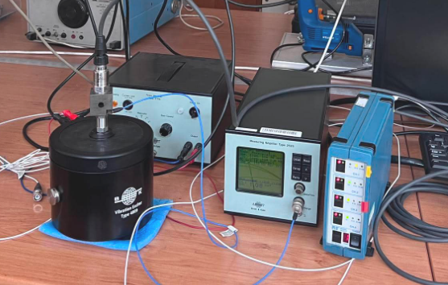
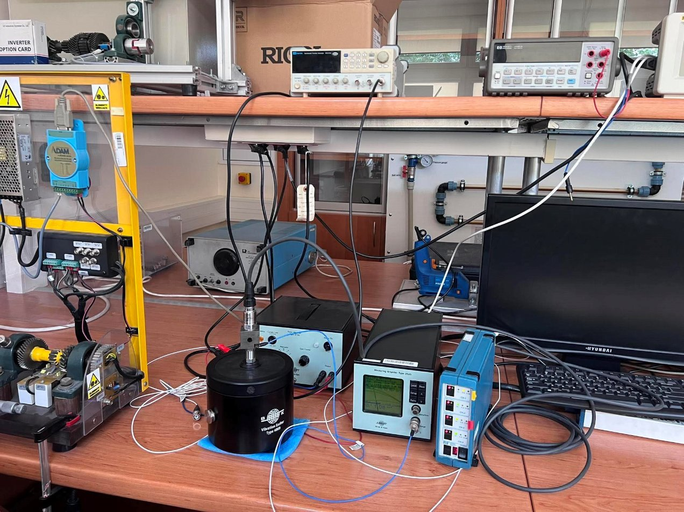
Sensor Calibration (Time: 20 min)
Sensor Calibration Setup
Describe the planned experiment:
To calibrate the test sensor (Model 601A02), we mount it directly onto the top of a precision reference sensor using a back-to-back method on a vibration shaker so both experience the exact same vibration. Connect the reference sensor and the test sensor to their own separate readout devices. Run the shaker at a stable reference frequency and acceleration level. Record the output voltage from the test sensor and the acceleration from the reference device simultaneously. Finally, calculate the actual sensitivity by dividing the test sensor's voltage by the reference acceleration, and use this new value to scale the sensor for future testing.

Slide 6
Sensor Calibration (Time: included in 20 min)
Calibration Results
Input channels
Sensor | Reference value | Measured value | Error | Comments
Model 601A02 | 500mv/g | 542mv/g | 42mv/g | 8.4% error. The sensor is more sensitive than the nominal factory rating. We can update software scaling to 542 mV/g.

Slide 7
DAQ Configuration (Time: 25 min)
DAQ Parameters
Acquisition mode
x Continuous (windowed around the trigger)
☐ Finite samples
Sampling frequency: 10000 Hz
Number of samples: 5000
Number of channels: 1
Measurement duration: 500ms (250ms before and 250ms after trigger event)
Comments:
The system is configured for pre- and post-trigger event capturing. A 5,000-sample window is acquired at a sampling rate of 10,000 Hz, which yields exactly 500 ms of data. Using a 50% pre-trigger buffer allows the system to save 250 ms of data leading up to the trigger event and 250 ms of data immediately following it, which is ideal for capturing transient phenomena or faults on the CNC machine.

Slide 8
Acquisition Software Development (Time: 40 min)
Current Acquisition Software Functions
x Data acquisition
x Real-time display
x Data logging
☐ Alarm system
x Signal processing
x FFT
☐ RMS
☐ Trend analysis
☐ Other
Comments:
The software operates on an event-driven display mode. Rather than constantly streaming live data, the display updates only after a trigger event occurs. Once triggered, the software captures the full data window, processes the Fast Fourier Transform (FFT) to convert the vibration data into the frequency domain, and then displays both the time-domain signal and the frequency spectrum simultaneously. This allows for a detailed review of the specific event that tripped the trigger.

Slide 9
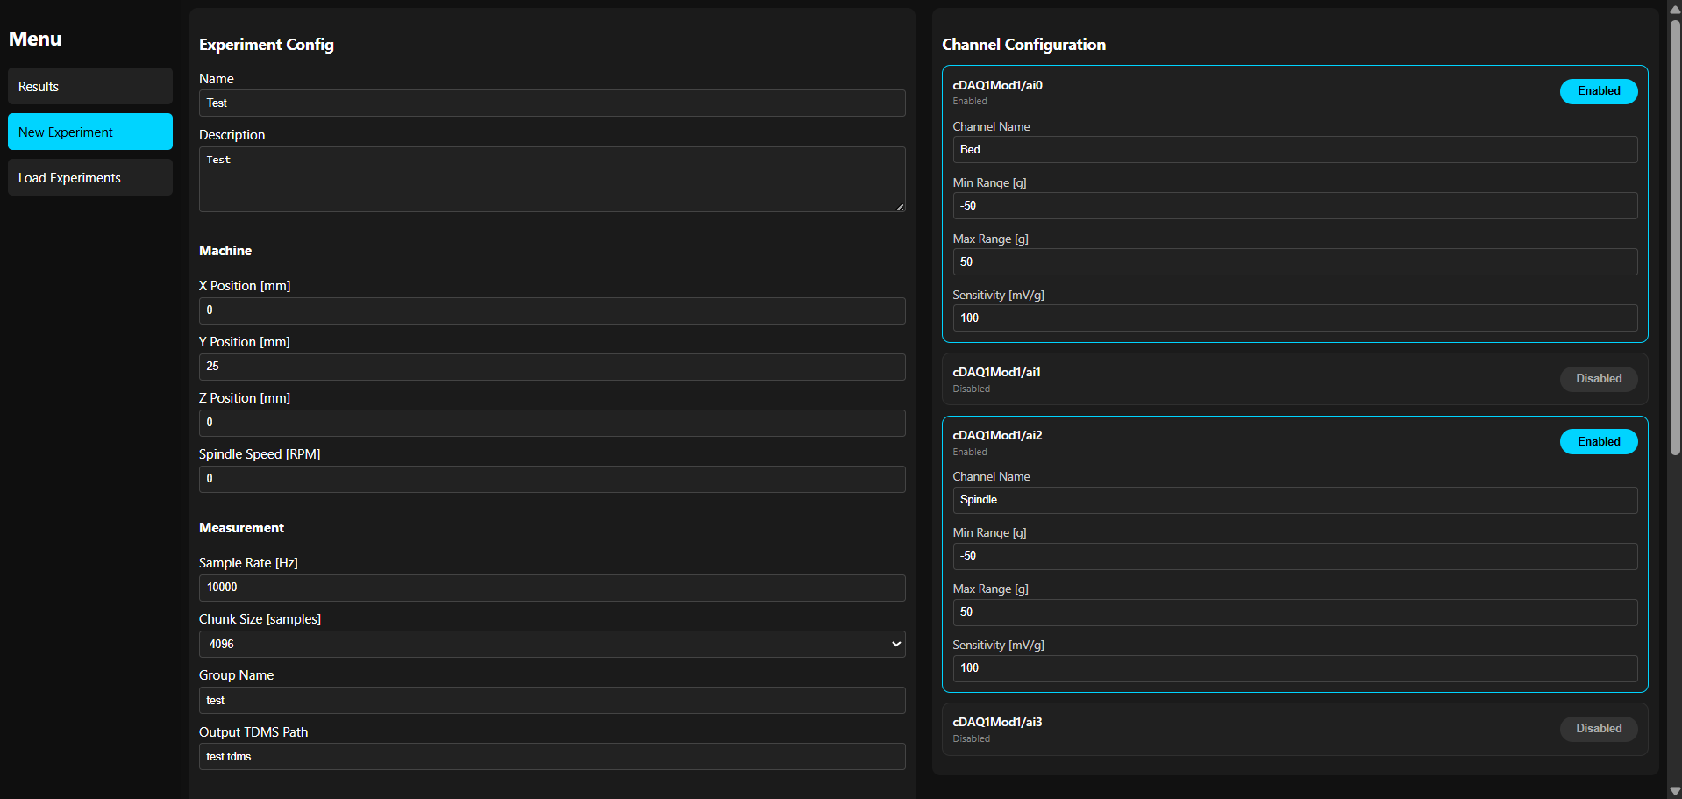
Acquisition Software Development (Time: included in 40 min)
Front Panel Design
Screenshot of current FP
Comments:
"New Experiment" section allows the user to configure sensors and channel settings

Slide 10
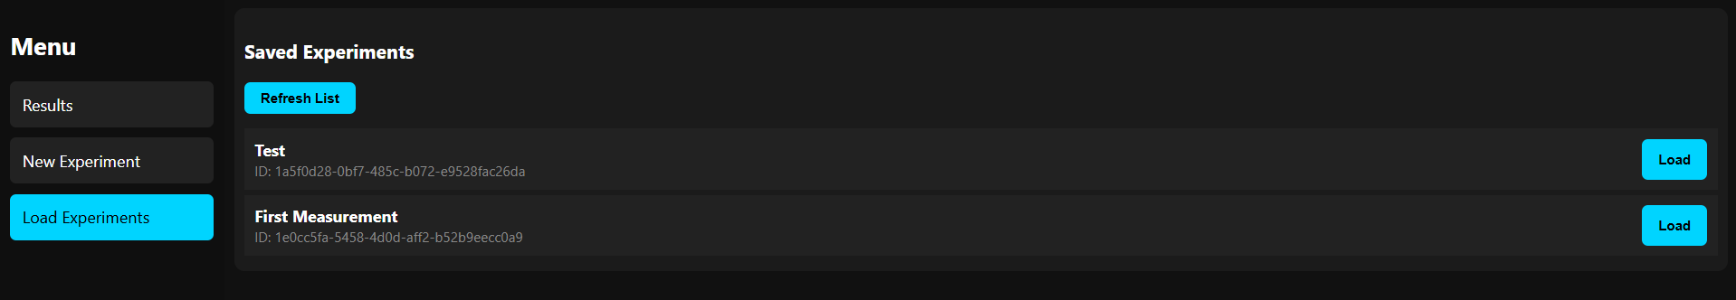
Acquisition Software Development (Time: included in 40 min)
Front Panel Design
Screenshot of current FP
Comments:
"Load Expermients" section allows the user to display previously saved data

Slide 11
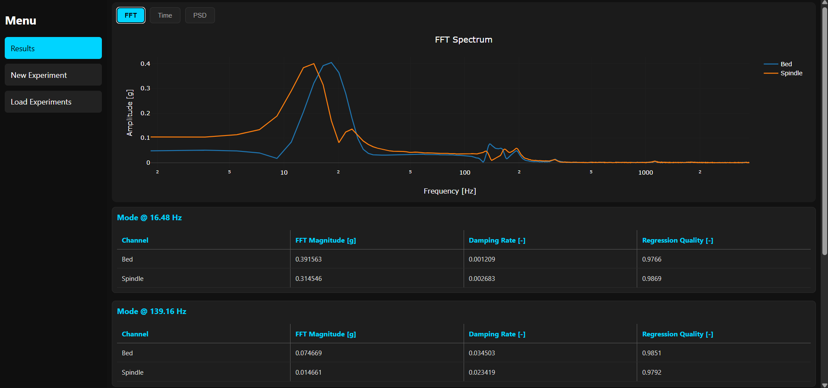
Acquisition Software Development (Time: included in 40 min)
Front Panel Design
Screenshot of current FP
Comments:
"Results" section displays the data aqcuired during the experiment on a plot. User can change between FFT, Time Domain and PSD plot representations (FFT plot)
)

Slide 12
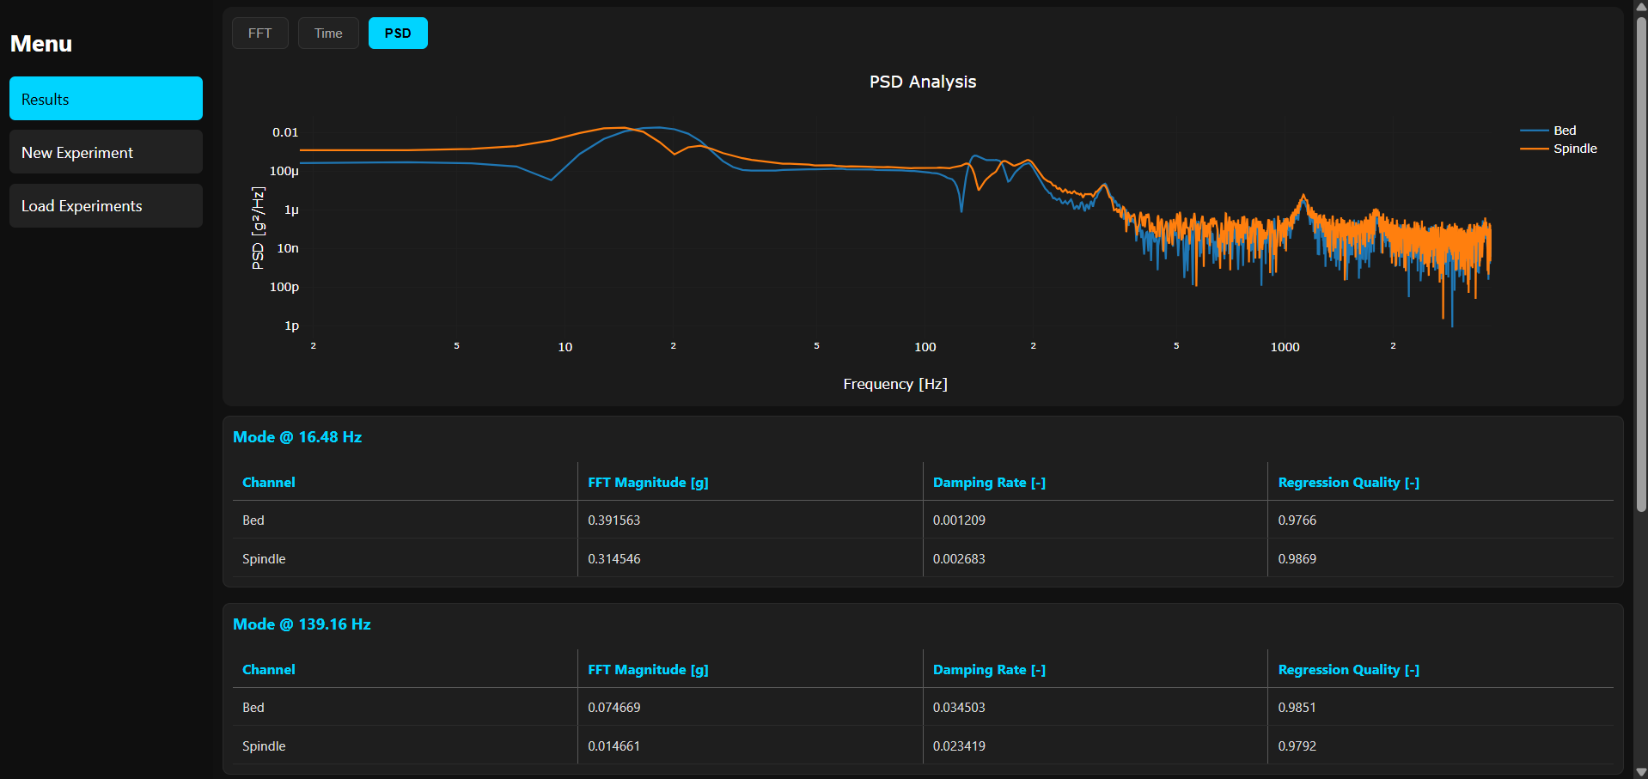
Acquisition Software Development (Time: included in 40 min)
Front Panel Design
Screenshot of current FP
Comments:
(Power Spectrum Density plot)

Slide 13
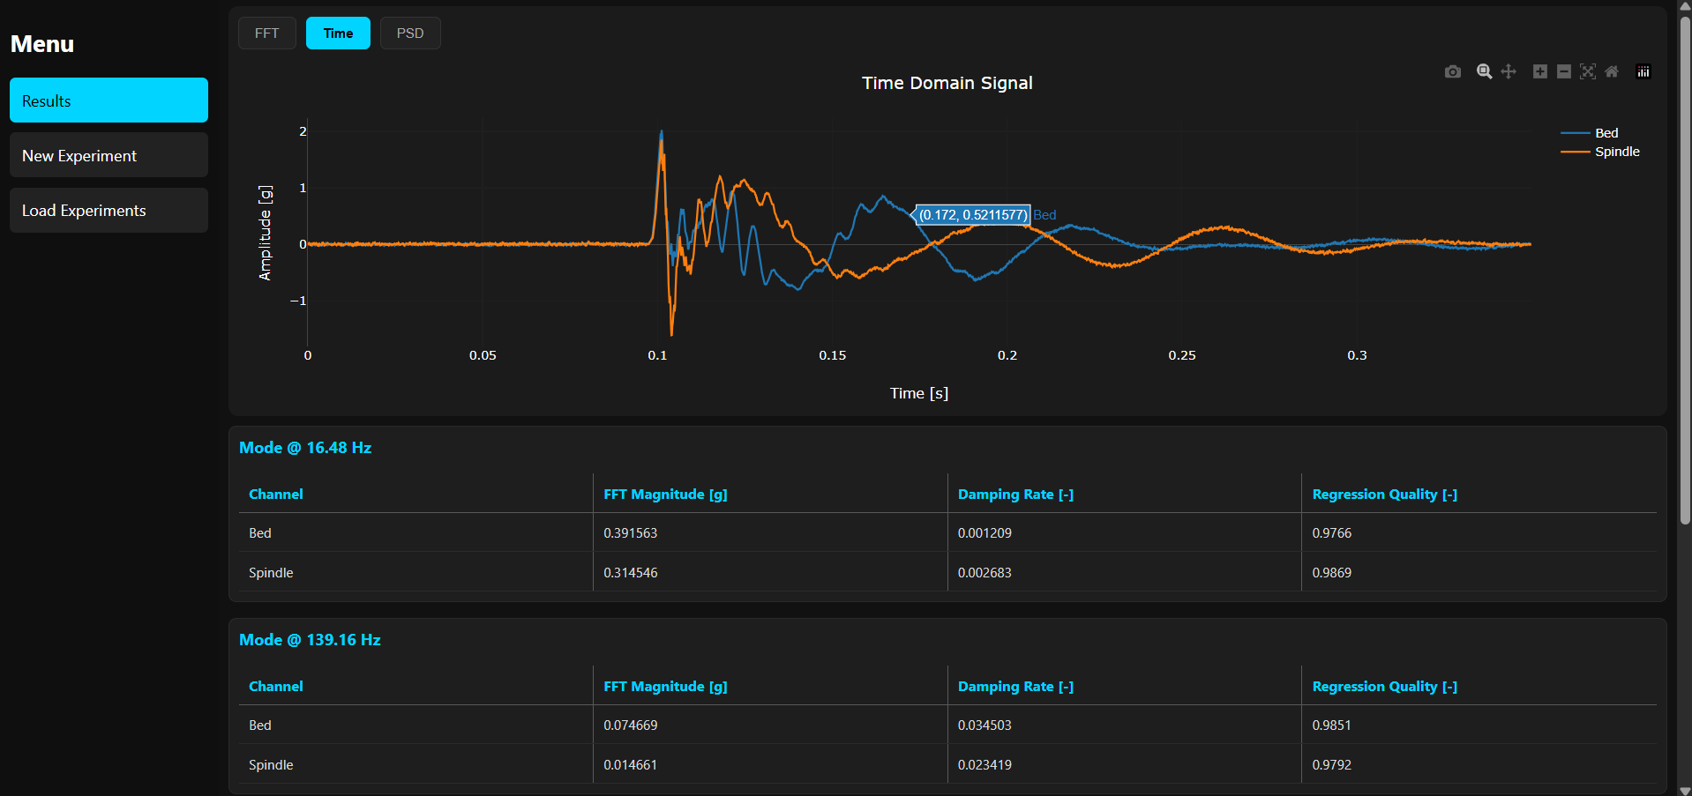
Acquisition Software Development (Time: included in 40 min)
Front Panel Design
Screenshot of current FP
Comments:
Hovering over a point on the plot displays the values (Time Domain plot)

Slide 14
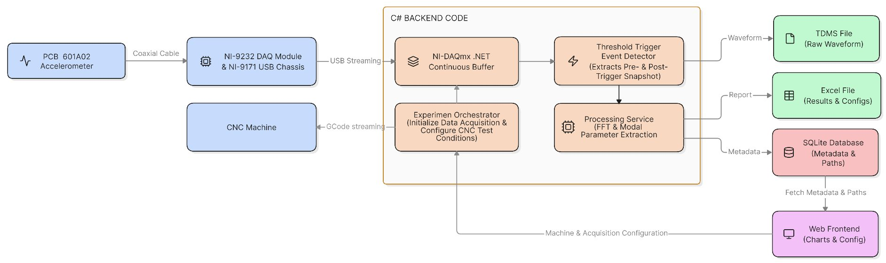
LabVIEW Development (Time: included in 40 min)
Block Diagram Design
Screenshot of current BD
Comments:
The system operates by continuously buffering analog vibration data in a C# backend until a physical strike triggers a precise pre- and post-trigger snapshot. The raw wave data is permanently saved to an TDMS file, while calculated results (such as FFT peak frequencies) and user configurations are logged into an Excel file. To tie everything together, an SQLite database acts as a master registry, storing experimental metadata alongside the absolute file locations of the generated TDMS and Excel reports. Finally, a web frontend queries this SQLite registry to locate the files, extract the data, and visualize the structural performance charts.

Slide 15
Preliminary Measurements (Time: 25 min)
Measurement Scenario
We performed a modal analysis on the CNC machine structure. By manually striking the machine bed with an impact hammer, we excited the structure to see how it vibrates naturally. This allowed us to isolate the machine's internal structural properties without the background noise of the spindle running.
Measurement objective
The goal was to identify the CNC machine’s natural resonance frequencies and its damping ratio. By knowing exactly at which frequencies the machine naturally "wants" to vibrate, we can warn operators to avoid those specific RPM ranges, which prevents chatter and reduces mechanical wear.
Test conditions
Excitation: Controlled mechanical hammer impact on the machine bed.
Setup: PCB Piezotronics 601A02 accelerometer mounted to the bed
Capture Logic: Our C# software used an automated trigger; it listened for the impact signal and saved a 500ms window (250ms before/after the hit)

Slide 16
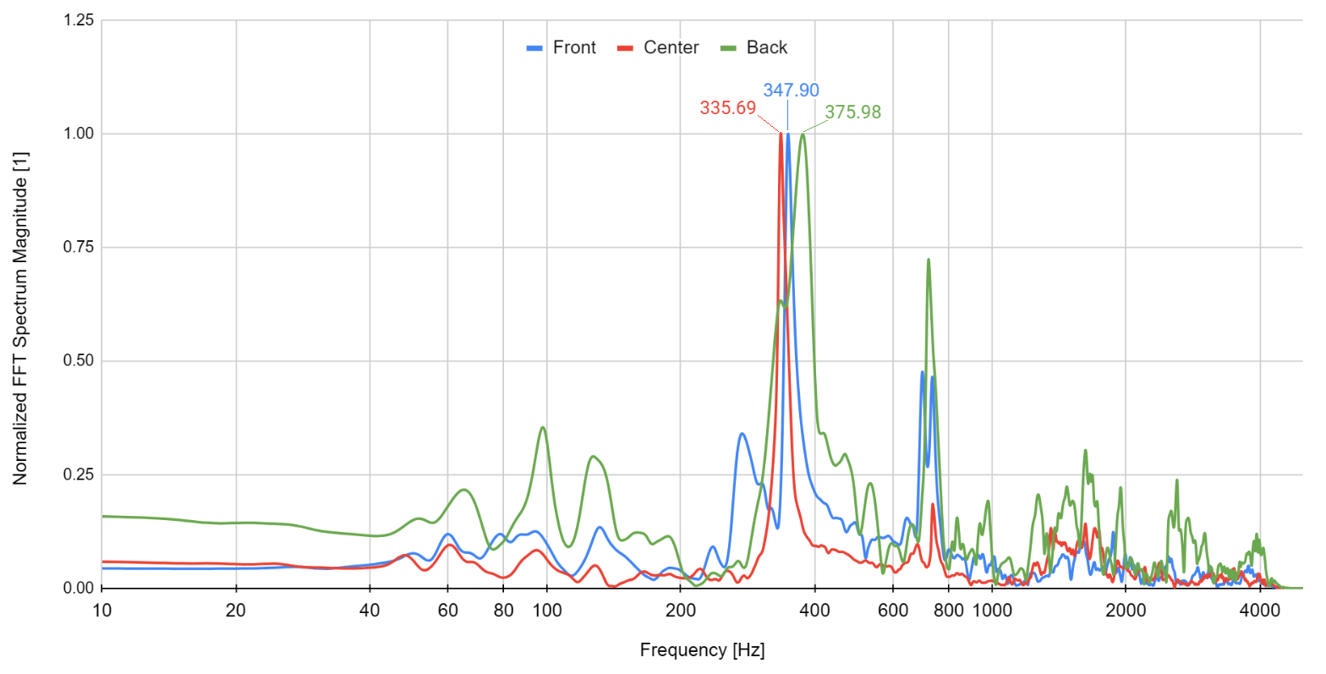
Preliminary Measurements (Time: included 25 min)
First Measurement Results
Initial observations
Dominant Resonance: We identified a clear structural resonance peak near 350 Hz across all configurations.
Position Sensitivity: The natural frequency shifted by about 12% depending on where the table was placed, proving that the machine's stiffness changes with the axis position.

Slide 17
Preliminary Measurements (Time: included 40 min)
Data Quality Assessment
Signal quality
x Excellent
☐ Good
☐ Acceptable
☐ Poor
Sources of uncertainty
☐ Noise
x Sensor accuracy
☐ DAQ limitations
x Experimental setup
x Other: experimental procedure (human error)
Conclusions
The signal quality is excellent, with high measurement repeatability and strong correlation between experimental trials. The primary uncertainties stem from the sensitivity of the sensor, the rigid mounting requirements of the experimental setup, and the inherent variability introduced by manual hammer impacts.

Slide 18
Sustainability Impact (Time: 10 min)
Based on current results, how can the project contribute to sustainability?
☐ Reduced energy consumption
☐ Reduced water consumption
X Reduced waste
X Extended equipment lifetime
X Predictive maintenance
X Reduced losses
Preliminary conclusions
Our experiments confirm that the CNC machine's dynamic behavior changes significantly with its table position, with a critical resonance zone near 350 Hz. By using our custom C# software to identify these frequencies, operators can avoid resonant speeds, which directly contributes to sustainability by reducing material waste from surface defects, minimizing energy losses from vibration, and extending the machine's service life through reduced structural fatigue.

Slide 19
Technical Challenges – Team Discussion (Time: 10 min)
Element | Status | Comments
Sensors | x OK / ☐ Problem
DAQ connection | x OK / ☐ Problem
Acquisition application | x OK / ☐ Problem
Data logging | x OK / ☐ Problem
Power supply / connections | ☐ OK / x Problem | Sometimes the connection with CNC machine gets lost especially during spindle spin-up, likely due to EMI interferences. After exchanging the cable for a different one we did not encounter this problem anymore
Experimental setup | x OK / ☐ Problem

Slide 20
Meeting 2 Summary (Time: included in 10 min)
Today we completed
x Hardware setup
x Sensor integration
x Calibration
x DAQ configuration
x Acquistion software development
x First measurements
x Final measurements
Overall project status
x Ahead of schedule
☐ On schedule
☐ Behind schedule

Slide 21
Tasks Before Meeting 3 (Time: 10 min)
Next step before Meeting 3:
Task | Responsible person | Deadline
Validate hammer impact TDMS files and check signal integrity | Patryk Januś | 16.06.2026
Analyze FFT peaks to isolate structural natural frequencies | Patryk Reiter | 17.06.2026
Prepare spindle operational test parameters (7,500 and 11,250 RPM) | Szymon Korzuch | 16.06.2026
Verify frontend plot rendering and prepare UI screenshots for the report | Natalia Szymeczko | 18.06.2026

